Slide 1
Bulgaria: legal reform in enforcement
Todor Lukov
Private Enforcement Agent,
Vice Chairman of the Ethics Committee
Of the Bulgarian Chamber of Private Enfoncement Agents

Slide 2
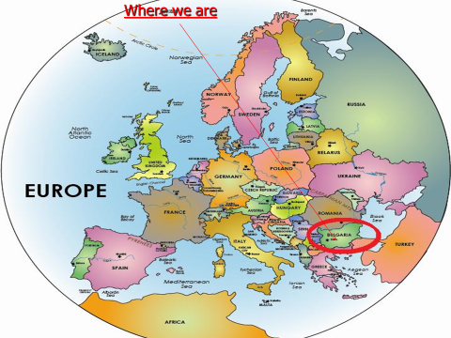
Topic - Theme
Developpment
Développement

Slide 3
Entry into the profession of
private enforcement agents (PEA)
in Bulgaria
1st stage - April 3rd 2006 – the former state enforcement agents were licensed as private enforcement agents by the virtue of their office
2nd stage - October 14th, November 11th 2006 the new enforcement agents were licensed by the Justice Minister and sworn in after first passing a two-stage exam
3rd stage – November 2013 – the new enforcement agents were licensed by the Justice Minister and sworn in after passing a 2-nd two-stage exam
Up to date - total 167 PEA
4th stage (in progress) 2015-2016 – the new enforcement agents after passing a 3-rd two-stage exam

Slide 4
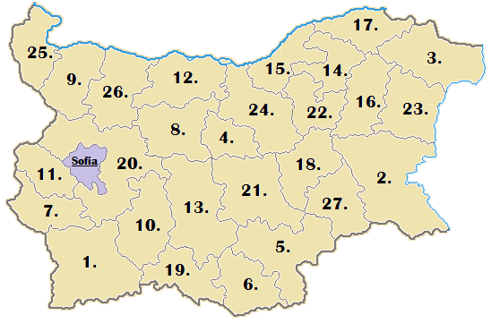
Territorial Jurisdiction of PEA 28 provincial courts regions
Developpment
Développement

Slide 5
In the 2006 annual report the World Bank
estimated the introduction of private judgment enforcement in Bulgaria as one out of ten most successful reforms on the world basis

Slide 6
Professional competence of PEA in Bulgaria:
Collection of private debts
Collection of public debts
Enforcement of special pledges
Enforcement of adjudicated actions or conduct
Process service
“Judicial” Enforcement
Enforcement of judgments (court decrees) CPC art. 404, 405, writ of execution (fieri facias)
Enforcement of judicial orders (order for execution)
- small claims (up to €12 550) & transfer of movables under pledge or lien CPC art. 410
- non-judicial instruments (acts) under art. 417 CPC:
administrative writs (under strict legislative delegation)
accounting excerpts denoting payables to state institutions; municipalities and banks
notary deeds & notarized contractual obligations
excerpts from the Special Pledges Registry certifying obligation to transfer property under lien
mortgage & lien contracts
bills of exchange; promissory notes and equal legal instruments
- writs for public dues for municipal taxes and fees (under the Municipal Taxation Act)
“Non-judicial” enforcement and other professional activities
- Auctioning property under lien according to the Special Pledges Act;
- Enforcement of titles under the Taxation and Social Security Procedural Act
- Process service
∙

Slide 7
Case load / Economic effect
⃰ Data estimate still in progress

Slide 8
Number of cases
January-
December
January-
December
January-
December
January-
December
January-
December
№ cases opened
№ cases closed

Slide 9
Amount collected (1BGN=0.51€)
January-
December
January-
December
January-
December
January-
December
January-
December
Amount per title
Amount collected

Slide 10
Key projects of BCPEA
https://newregistry.bcpea.org/
Central Debtors’Registry (CDR)
The Central Debtor’s Register /CDR/ established by The Bulgarian Chamber of PEA is a centralized database of all PEA countrywide
Functionalities and features:
Check whether a potential counterpart (corporate entity) is involved in enforcement proceedings;
Check whether oneself is involved in proceedings a debtor;
Inquiries and related fee payments are performed electronically in the PEA offices;
Remote access of corporate clients to the database (in process of approval);
Over 1 million cases accessible;

Slide 11
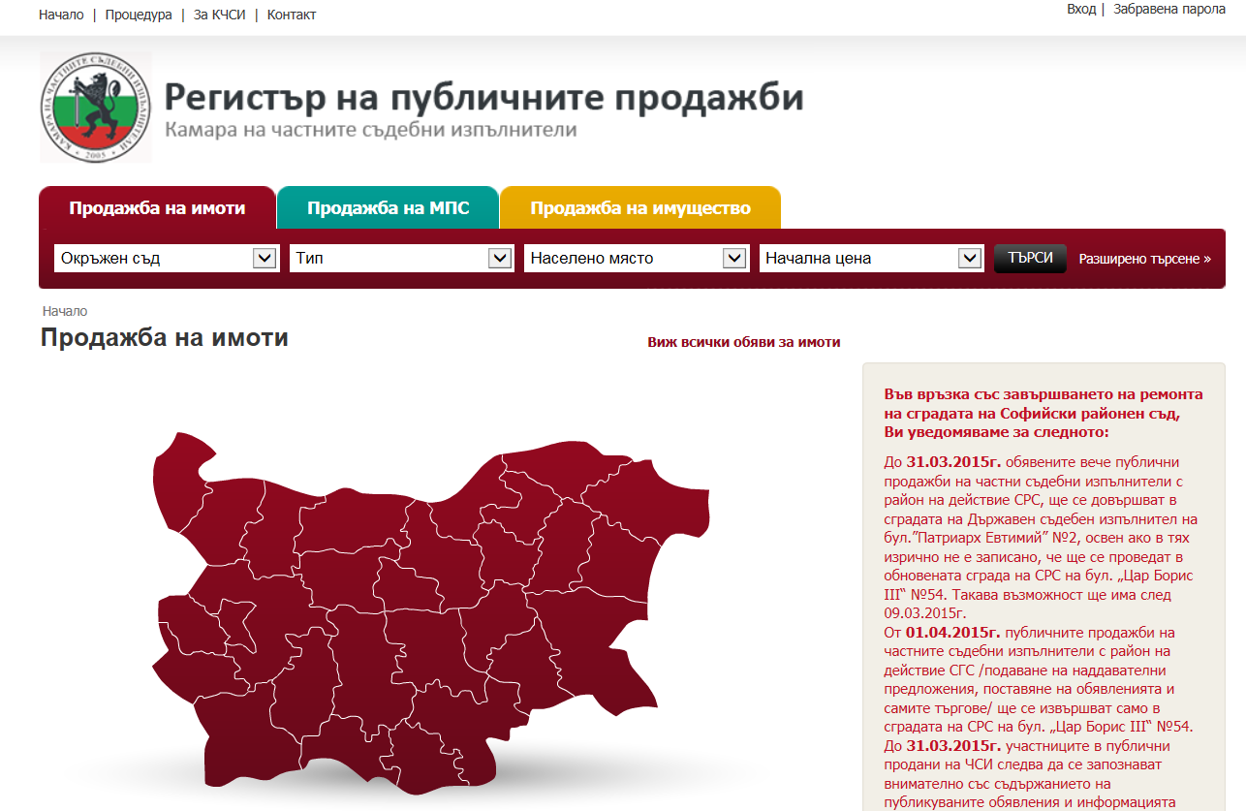
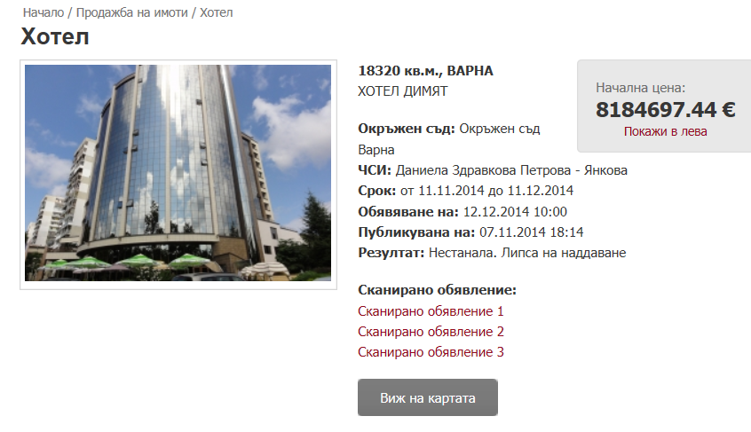
Key projects of BCPEA
http://www.sales.bcpea.org/
Registry of Auctioned Property

Slide 12
Thank you - Merci
Todor Lukov
Private Enforcement Agent,
Vice Chairman of the Ethics Committee
Of the Bulgarian Chamber of Private Enforcement Agents

