Slide 1



Santander
Economic Research
Economic Outlook: Tailwinds for growth
June 2015
Notes:
1

Slide 2

2
Economic Outlook: Tailwinds for Growth
A number of tailwinds ensure a better growth outlook in Europe, amplifying positive dynamics where they existed (Germany, Spain) and creating some traction where they didn’t (France, Italy)
  Lower oil prices
  Lower euro
  A more neutral fiscal policy
  Monetary expansion
In the US, abstracting from seasonal effects (Q1 winter freeze, West coast port strike), the cycle is maturing & the Fed getting ready for rate lift-off
China is slowing beyond what was designed, but also getting ready for a bigger international role

Slide 3

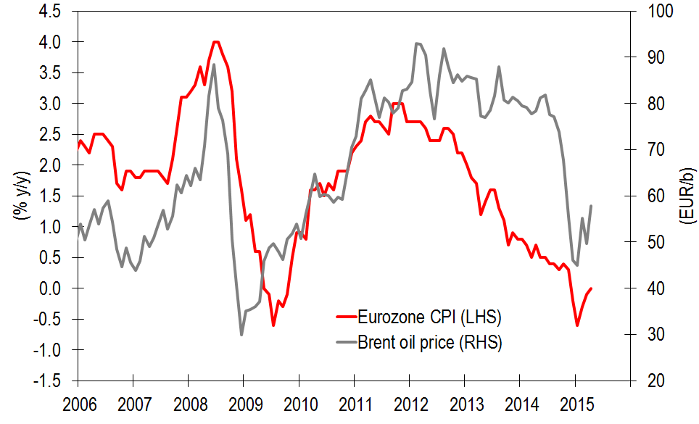
3
Tailwinds for Growth: Lower Oil Prices
Brent oil price (€/b) and Euro zone CPI (% y/y)
Source. Eurostat, Bloomberg, Santander
Oil prices in € terms are now 37% cheaper than in the summer of 2012
  Crude prices no longer tanking, but much of the decline is here to stay
  More on this later…

Slide 4
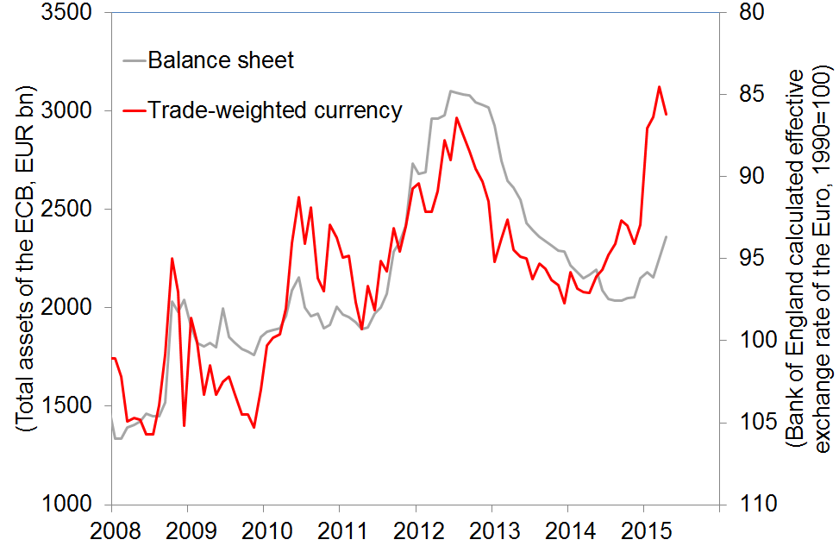
4
Tailwinds for Growth: Lower Euro
ECB total asset (€ bn) and Euro trade-weighted exchange rate (inverted scale)
Source. ECB, BoE, Bloomberg, Santander
The trade-weighted Euro is now 13% lower than at the end of 2013
  Large part of decline in late 2014-early 2015, as market anticipated QE
  Much further depreciation unlikely

Slide 5
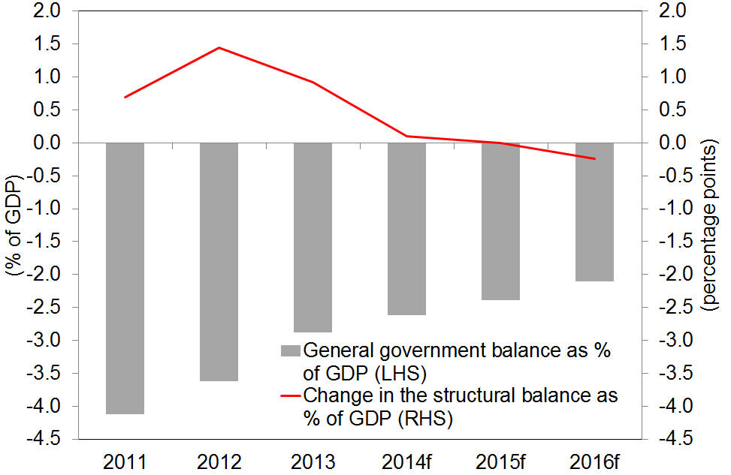
5
Tailwinds for Growth: A less hostile fiscal policy
Euro zone budget deficit and change in the structural deficit (% of GDP)
Source. European Commission, Santander
From a 1.5% of GDP tightening to a 0.3% of GDP expansion
  Headline deficits narrowing anyway courtesy of (i) a little more growth, and (ii) much lower funding costs

Slide 6
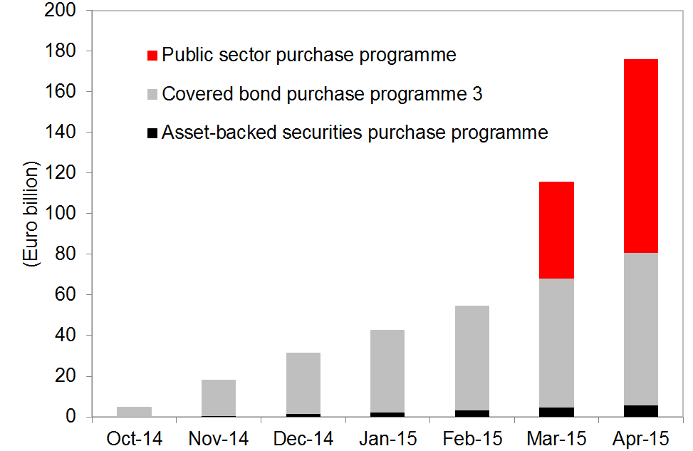
6
Tailwinds for Growth: Massive monetary expansion
Eurosystem holdings under the Extended Asset Purchase Programme (EUR bn)
Sources. ECB, Santander
Commitment to stay at ZLB in policy rates for the foreseeable future
Launch of EAPP: €60bn/month from March 2015 to September 2016
  No wavering in the commitment to execute the programme in full
  Will keep yields low across the curve for months to come

Slide 7
7
Tailwinds for Growth: Tide is lifting all boats
Euro zone GDP growth forecast. 1.6% in 2015E, 2.0% in 2017E
Tailwinds amplifying positive growth dynamics where they previously existed (Germany, Spain) …
…and generating traction where they did not previously present (France, Italy)
Structural reforms remain key (more on this later)

Slide 8
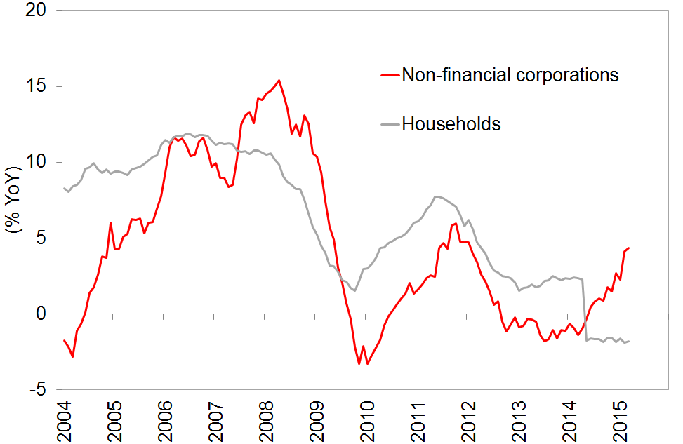
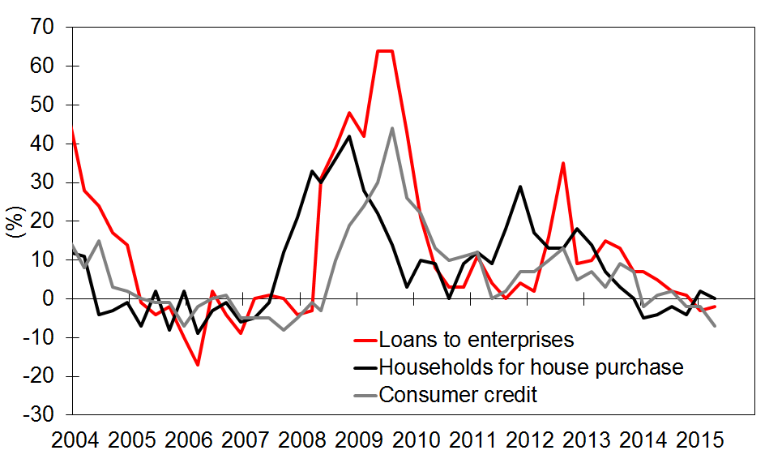
8
And a wildcard: credit growth
France: Loans to NFCs and households (% y/y)
Euro zone: % of banks tightening lending standards
Source. ECB, Bloomberg, Santander
Source. ECB, Bloomberg, Santander
Bank credit about to return to growth, fostering personal and capital spending
  Banks have been already easing lending standards for a few quarters
  Credit growth already present in some segments/countries

Slide 9

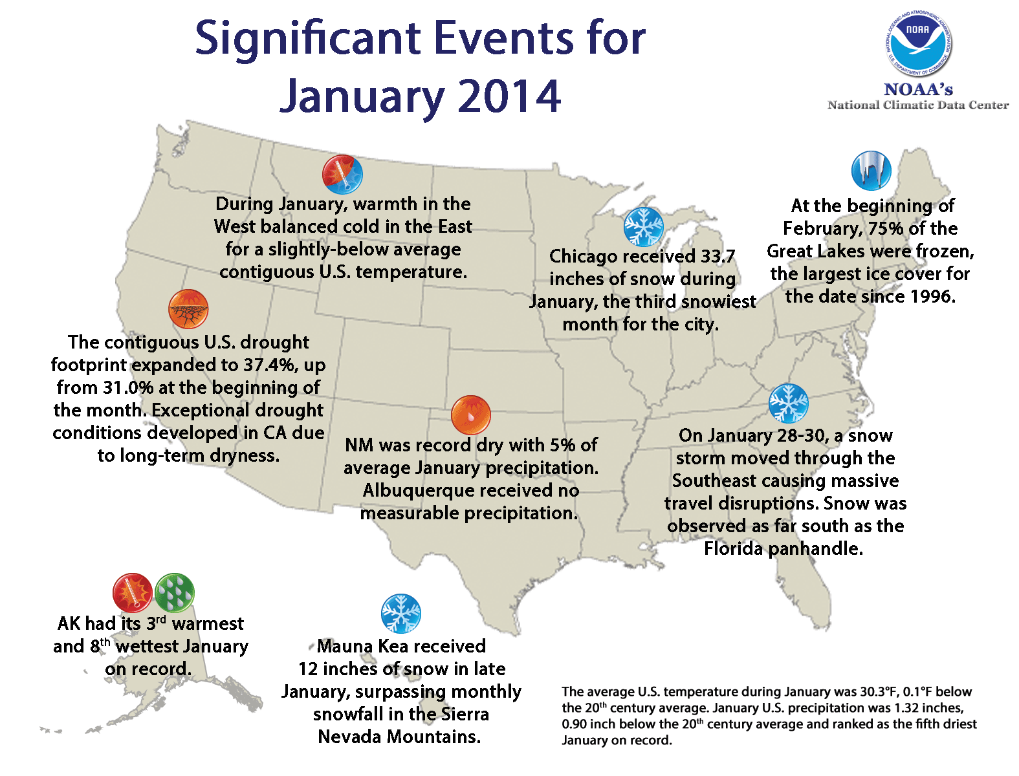

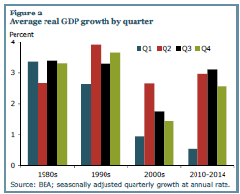
9
Another Q1 one-off
Sources. NOAA, Federal Reserve Bank of San Francisco
A number of anomalies/distortions tarnishing Q1 GDP numbers
  Unusually cold weather
  West Coast port strikes
  Pitfalls in seasonal adjustment affecting Q1

Slide 10
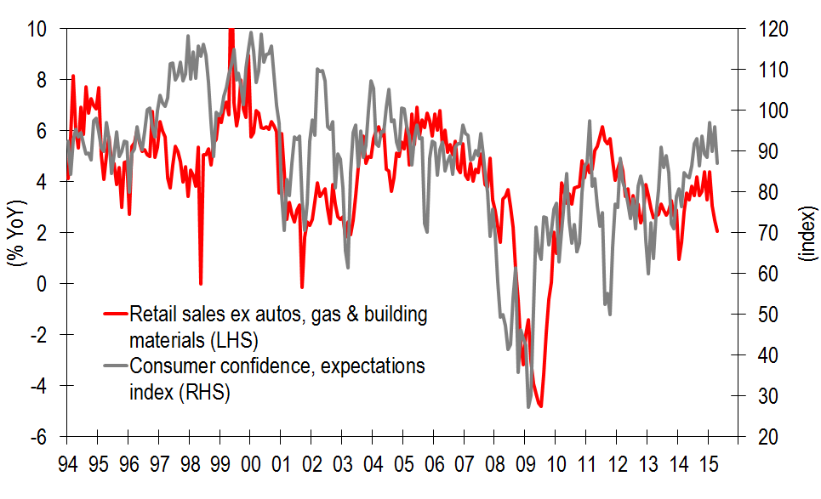
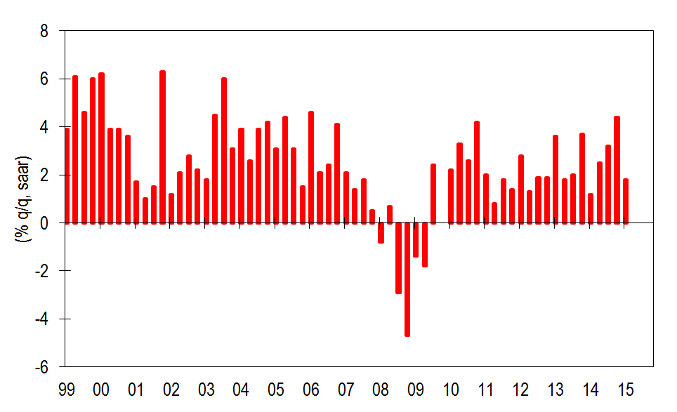
10
Personal spending holding just fine
US: Consumer confidence and retail sales
US: Household consumption
Sources. Conference Board, US Census Bureau, Bloomberg, Santander
Sources. BEA, Bloomberg, Santander

Slide 11
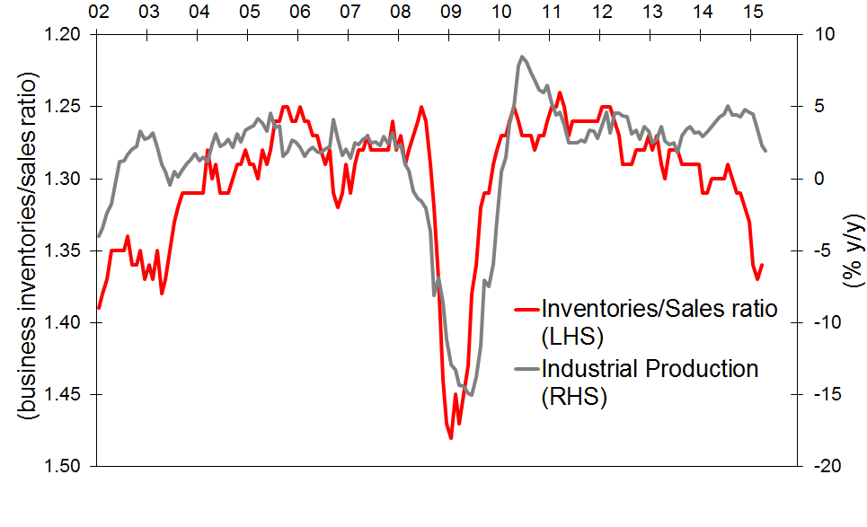
11
Oil & gas drilling dragging down IP and capital spending
US: Inventory/sales ratio and IP
Sources. US Census Bureau, Federal Reserve, Bloomberg, Santander

Slide 12
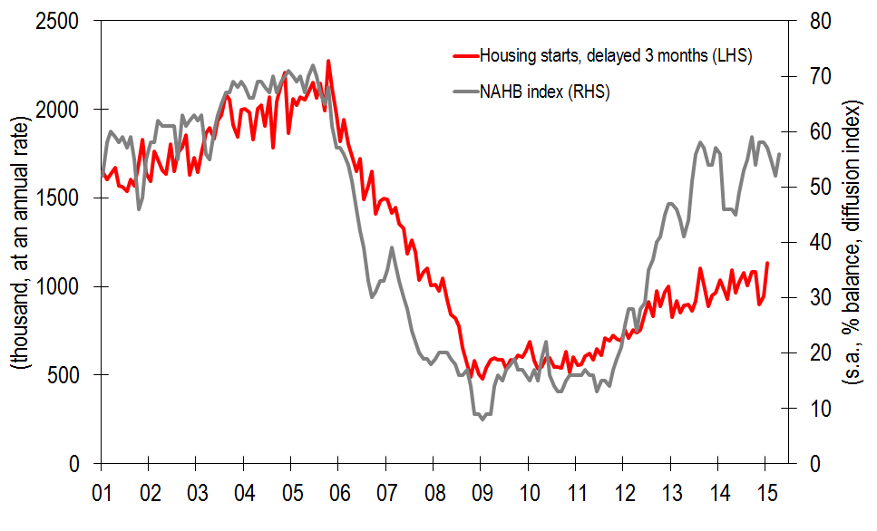
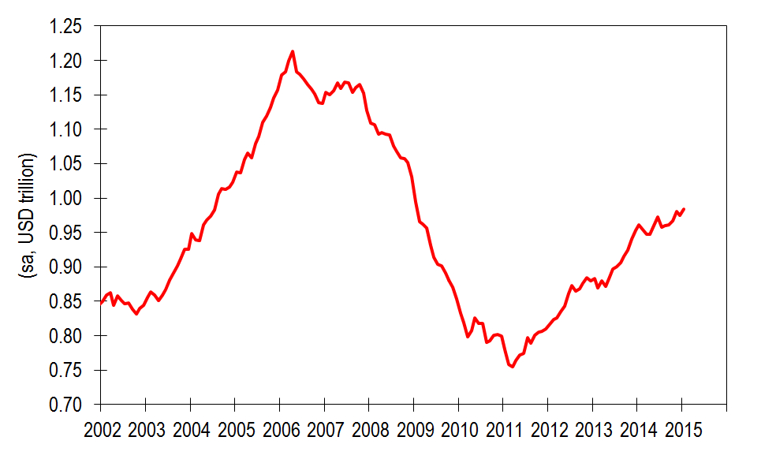
12
Housing and construction again on a roll
US: Homebuilders’ confidence and housing starts
US: Construction spending
Sources. US Census Bureau, NAHB, Bloomberg, Santander

Slide 13
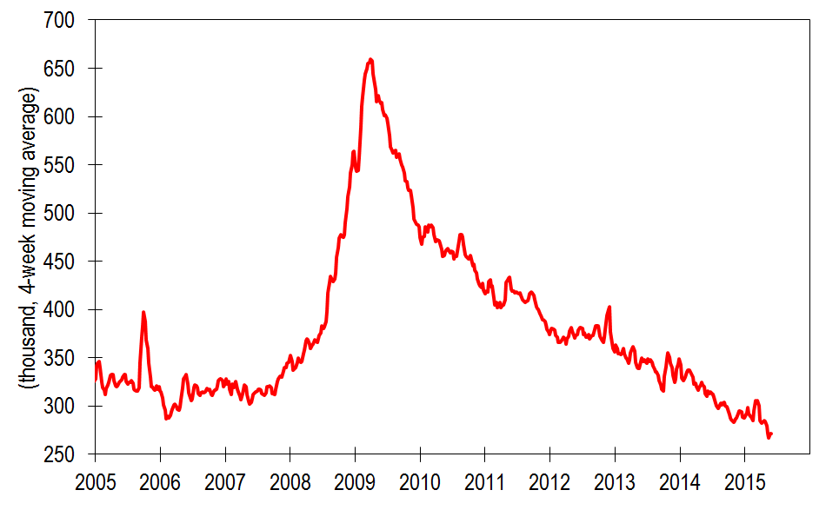
13
Labour market steadily improving
US: Weeklñy jobless claims (4-week m.a.)
Sources. BLS, Bloomberg, Santander

Slide 14
14
How labour market metrics have previously
behaved around Fed tightening episodes (i)

Slide 15
15
How labour market metrics have previously
behaved around Fed tightening episodes (ii)

Slide 16

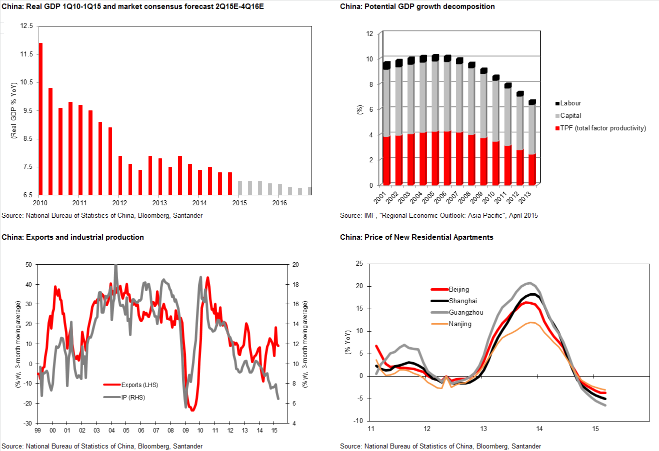
16
A slowdown that goes way beyond design

Slide 17
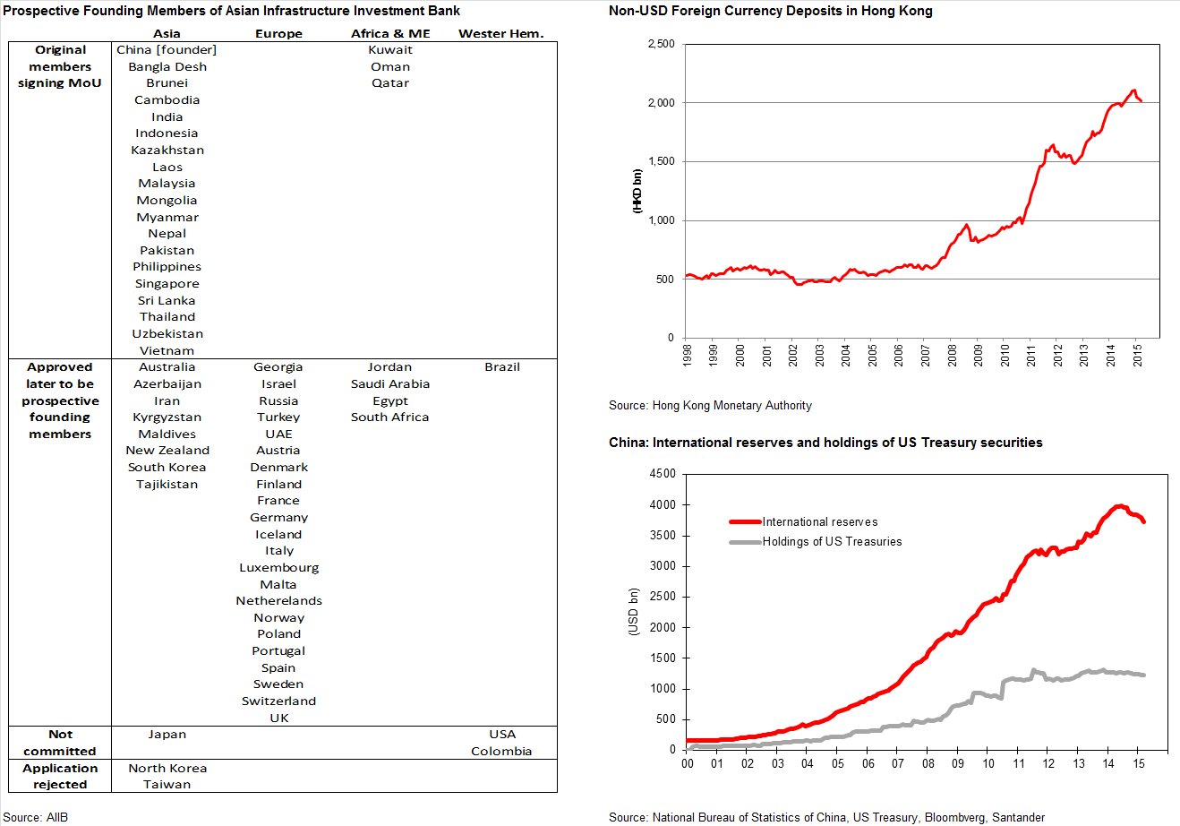
17
China getting ready for a much bigger international role

Slide 18
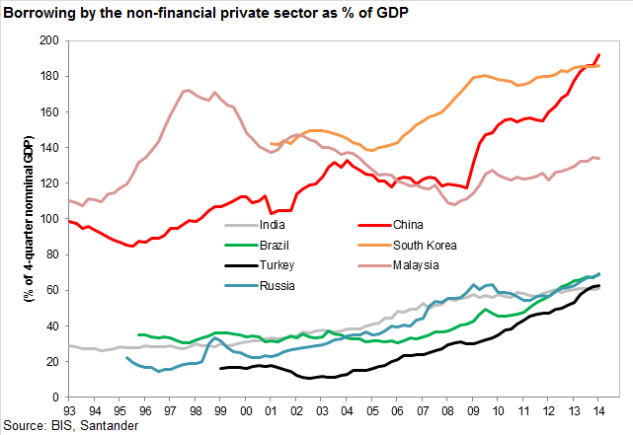
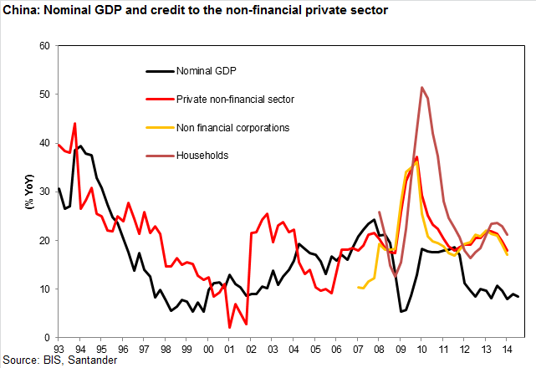
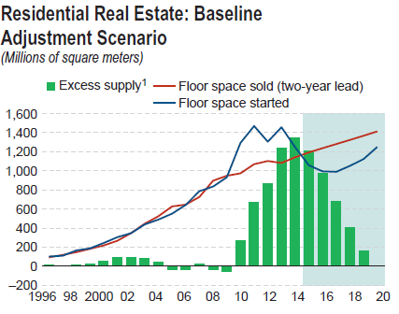
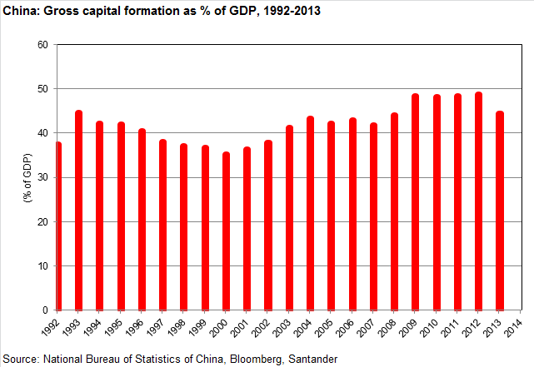
18
Imbalances looming large
Source: IMF, Asia-Pacific Regional Economic Outlook, April 2015

Slide 19






19
  Some macro themes
Current account, competitiveness, and corporate margins
Oil shock
Secular stagnation debate
Inflation/deflation risks
Taking stock of structural reforms
Emerging markets

Slide 20



Oil shock
=
Even one of the most basic iWatches would buy us today 1,831 liters of oil !!!

Slide 21
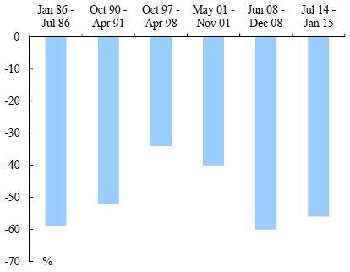
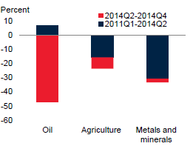
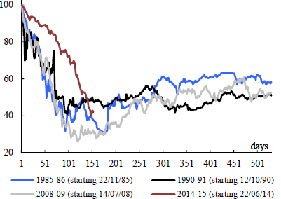
Oil shock:
Fall in oil prices (and other commoditiy prices) is substantial
Oil price drops in excess of 30%
Cumulative changes in commodity price indexes
Duration of oil price declines
(1st day of selected period=100)
NOTE: Non-consecutive episodes of six-months for which weighted average of WTI, Brent and Dubai oil prices fell by more than 30%
Source: European Commission
NOTE: Unweighted average of 3 oil benchmarks, 21 agricultural goods, 7 minerals and metals prices
Source: The World Bank
Source: ICE, European Commission
The present fall in oil prices is a significant event compared to other similar historical episodes:
  1985-86: Increase in oil supply and change in OPEC policy
  1990-91: US recession
  1997-98: Asian crisis
  2001: US recession
  2007-09: Global financial crisis
Significant declines also in other commodity prices

Slide 22
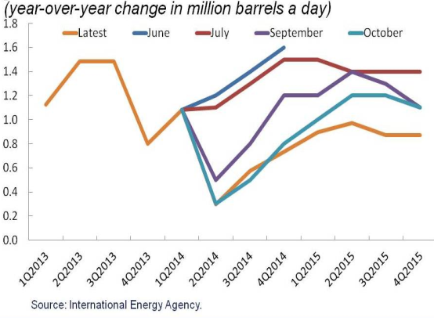
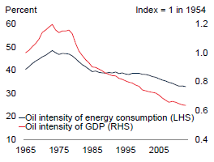
Oil shock:
Why has the oil price been tanking?
IEA forecast of global oil demand growth
Oil intensity of GDP and energy consumption
NOTE: Oil consumption relative to GDP, 1954=1. Oil consumption as % of total energy consumption
Source: The World Bank
A structural increase in SUPPLY
  Huge increase in US shale oil and gas production
Lower oil DEMAND, which is partly transitory, partly structural
  Transitory decline in demand due to deceleration of global growth (downward revision of demand 0.8mb/d in 2014H2)
  A structural decline in oil intensity of world GDP
Failure of OPEC to agree on production cuts in November 2014
Geopolitical concerns

Slide 23
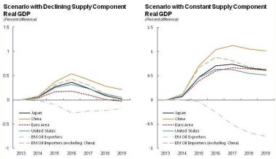
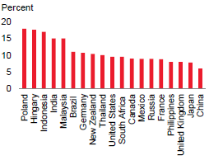
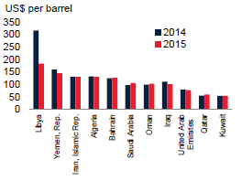
Oil shock:
Economic effects of the lower oil price
Weight of energy in national CPIs
Oil producer fiscal breakeven prices
NOTE: In first scenario, supply shift accounts for 60% of price decline, in scenario 2 the price shift is undone over time
Source: IMF
Source: World Bank
Source: World Bank
Real income changes
  Gains for oil importers, losses for oil exporters
  Depends on share of energy intensity and on share of exports/imports of oil in GDP
  Might shift income from high savings exporters to high spending importers, decrease liquidity in wealth funds
Decrease in input cost of production
  Lower costs of producing goods
Lowers inflation
  Depends on pass-through of oil prices to wages and other prices
  Depends on monetary policy response
Net effect on growth according to IMF: 0.3-0.7% in 20015, 0.4-0.8% in 2016

Slide 24
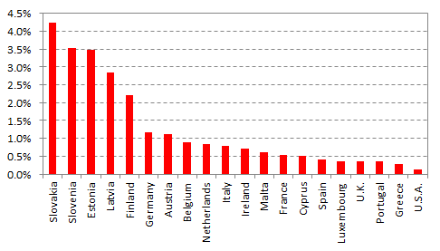
Oil shock:
Ukraine + Russia, two sides of the story
Export to Russia + Ukraine as % of GDP
Gas and oil pipelines from Russia and gas supply
dependence on Russia
  USA: no direct economic exposure or energy exposure to Russia, only a geopolitical one
  Europe: the farther to the north, the farther to the East, the more exposed

Slide 25

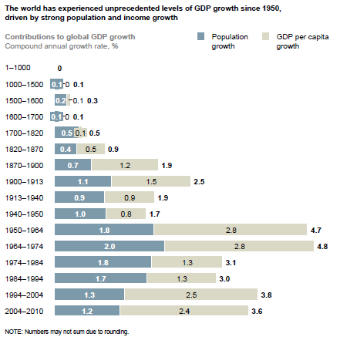
Population and income growth in history
Contributions to global growth, 0-2010
Source: A. Maddison, Jutta Bolt and Jan Luiten van Zanden, “The first update of the Maddison Project: Re-estimating growth before 1820”, Maddison Project working paper number 4, University of Groningen, January 2013; United Nations Population Division; McKinsey Global Institute “Global Growth: Can Productivity Save the Day in an Aging World?”, January 2015

Slide 26
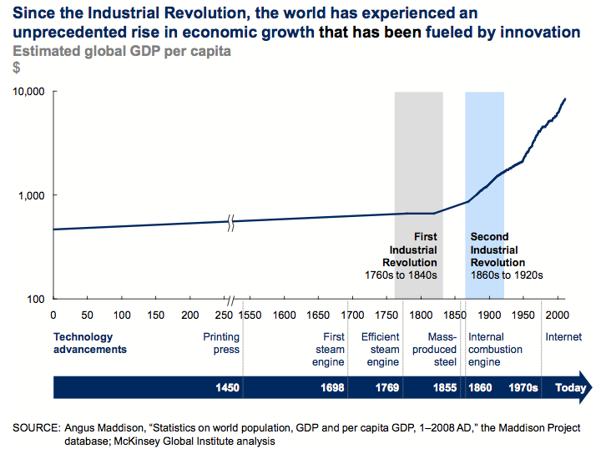
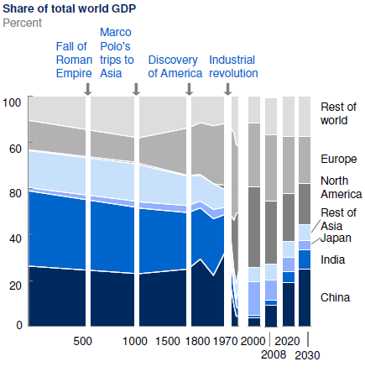
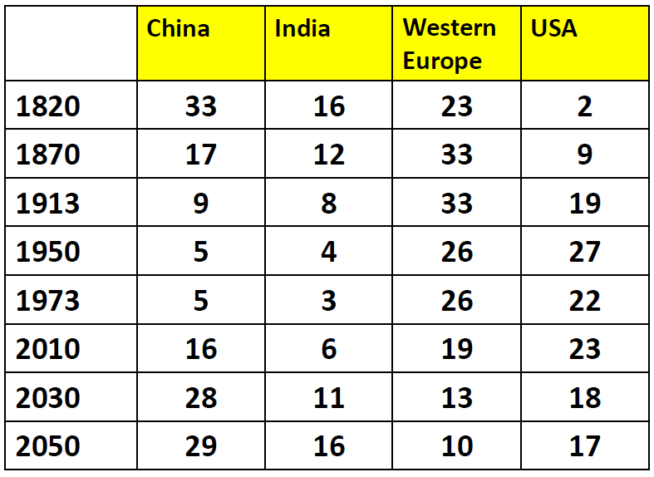
“Same as it ever was….”
Global GDP per capita, 0-2010
Distribution of World’s GDP, 0-2030f
Source: A. Maddison, “The World Economy: A Milenial Perspective” , OECD, 2001
Shares of World GDP (%)
“Chaiman Mao, what do you think of the French revolution?”
“I think it is too early to tell”

Slide 27
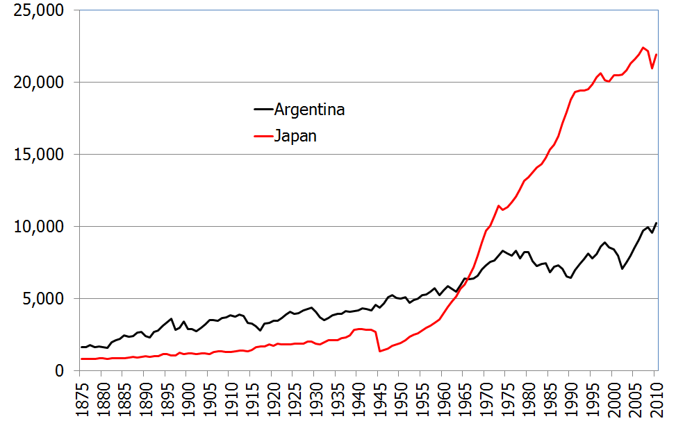
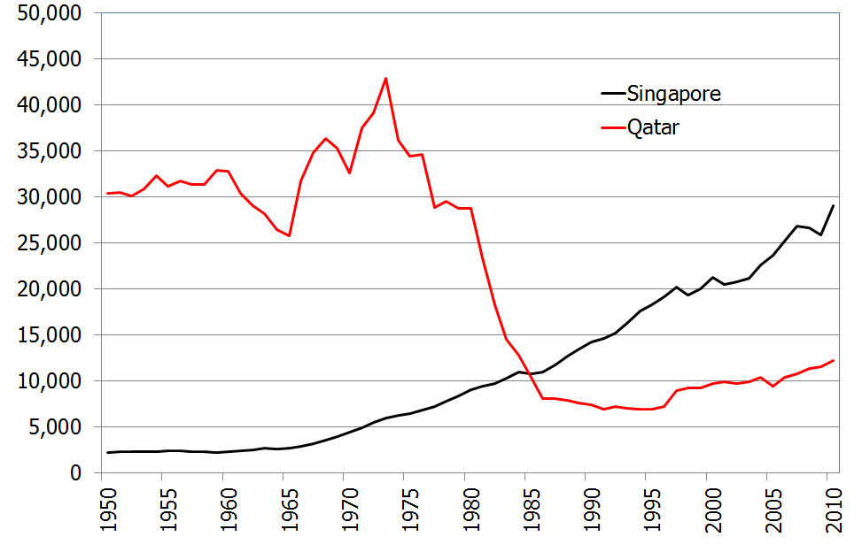
Development mistakes/accidents can be very costly…
GDP per capita (1990 PPP USD)
  Argentina had about the same GDP per capita as the US in 1895, and was richer than Japan until 1967
  Resources price swings/stock exhaustion can have massive impact for commodity exporters
Source: The Maddison-Project, http://www.ggdc.net/maddison/maddison-project/home.htm, 2013 version

Slide 28
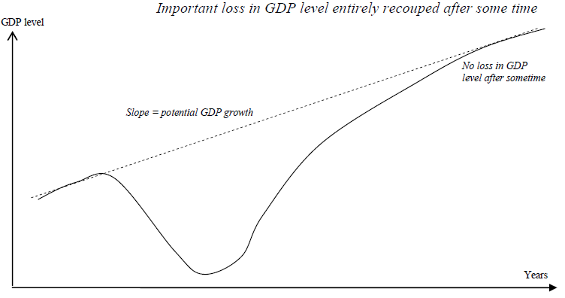
Models of reaction to the crisis
No loss of potential growth, eventual convergence to potential growth trajectory
Source: European Commission, “Impact of the current economic and financial crisis on potential output”, European Economy Occasional Papers 49, 2009

Slide 29
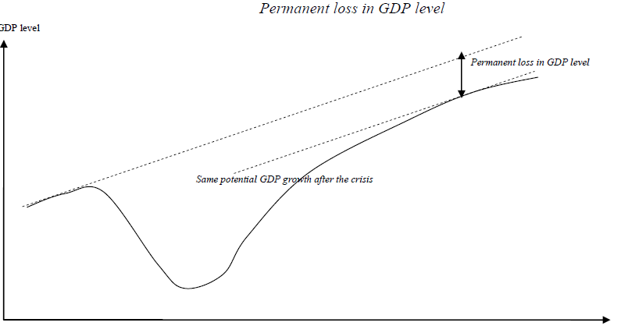
Models of reaction to the crisis
No change in potential growth in the long run, permanent loss in potential GDP level
Source: European Commission, “Impact of the current economic and financial crisis on potential output”, European Economy Occasional Papers 49, 2009

Slide 30
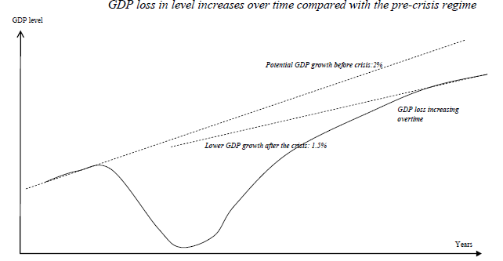
Models of reaction to the crisis
Permanent loss in potential GDP level and downward shift in potential growth
Source: European Commission, “Impact of the current economic and financial crisis on potential output”, European Economy Occasional Papers 49, 2009

Slide 31
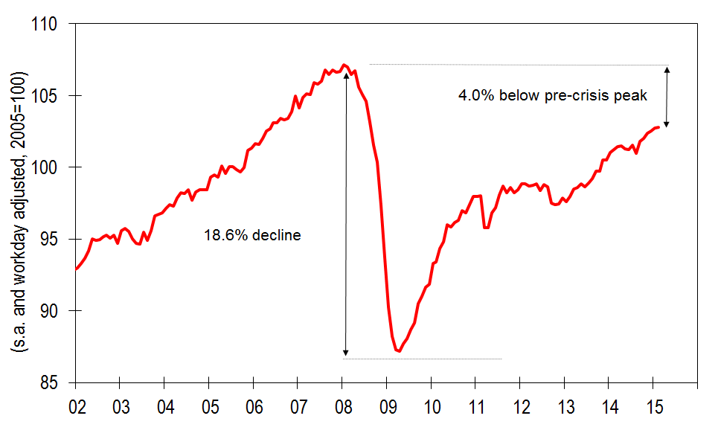
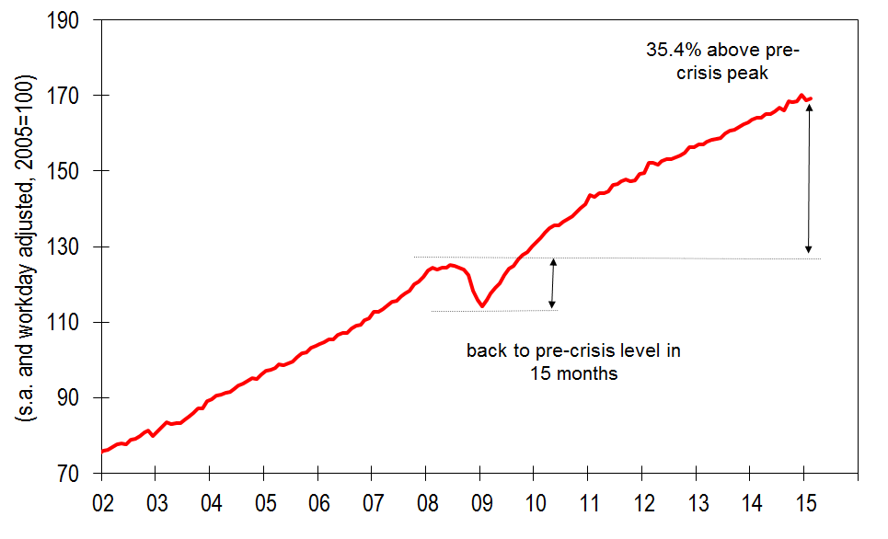
Advanced vs. emerging economies (big picture)
A high-frequency measure of activity: industrial production (2005=100)
Advanced economies
Emerging economies
  Advanced economies took a 18.6% hit during the crisis, and seven years later they are still 4% below the pre-crisis peak
  It took emerging economies just 15 months to recover the pre-crisis peak and they are now 35.4% above that level
Source: CPB Netherlands Bureau for Economic Policy Analysis

Slide 32
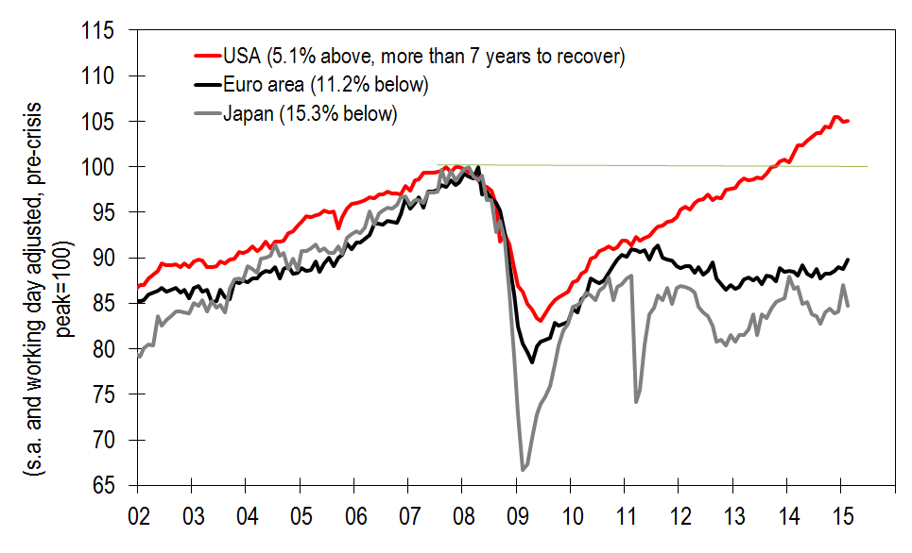
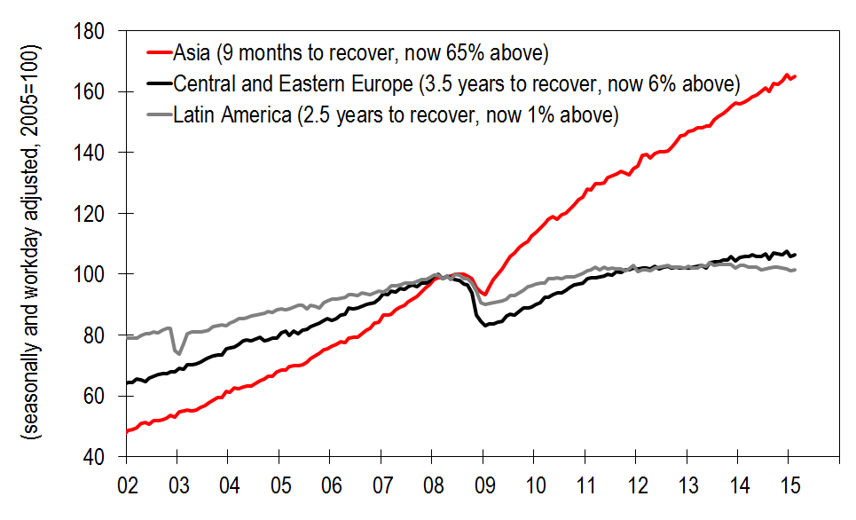
Advanced vs. emerging economies (the gory details)
A high-frequency measure of activity: industrial production (pre-crisis peak=100)
Advanced economies
Emerging economies
  The devil is in the details…
          In advanced economies, USA doing well, Japan and Eurozone ex Germany doing pretty miserably)
          In emerging economies, most of the gains come for Asia, and LatAm rapidly losing steam in the last two years
Source: CPB Netherlands Bureau for Economic Policy Analysis

Slide 33
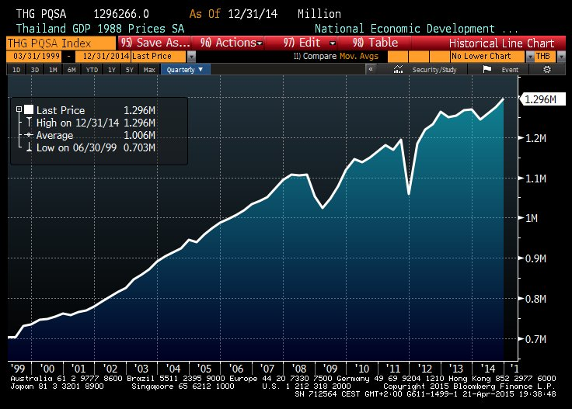
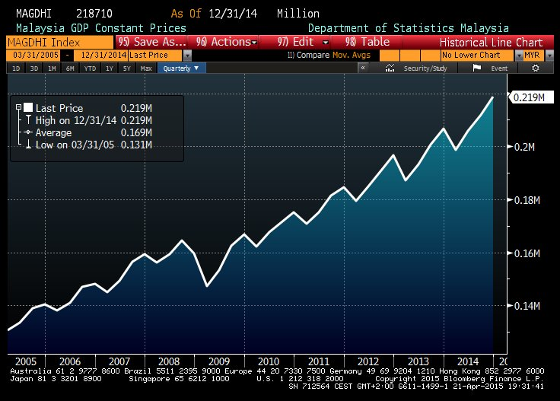
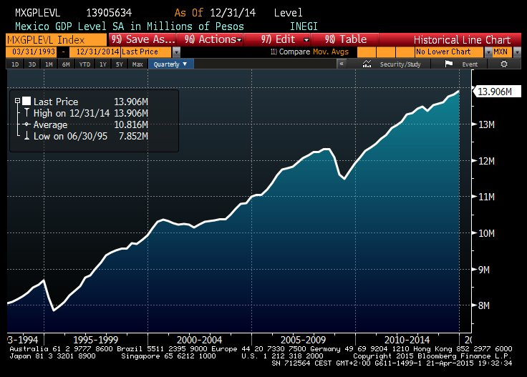
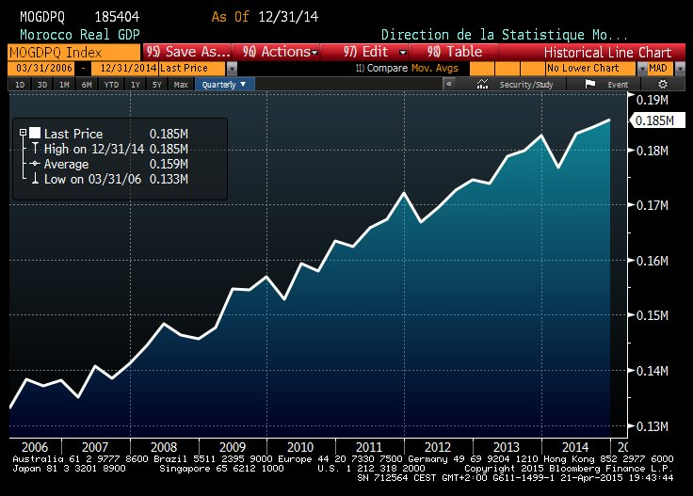
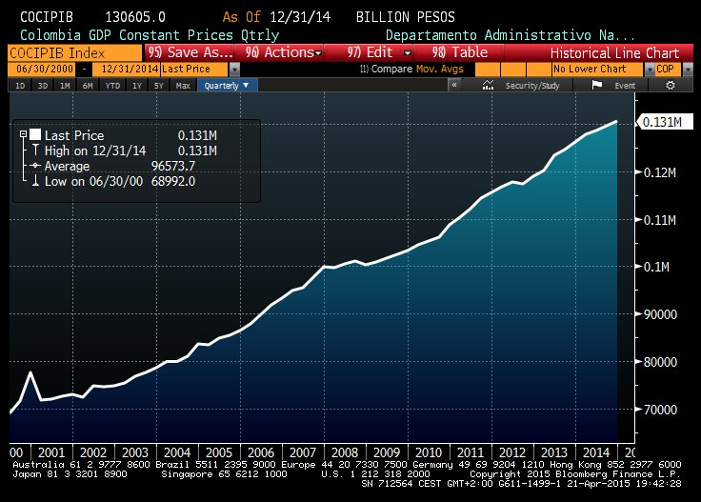
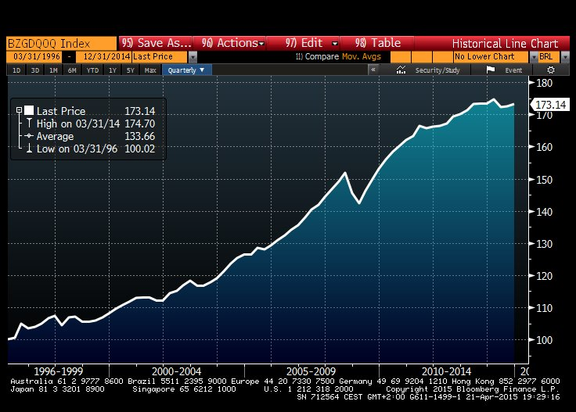
Country evidence on GDP post-crisis performance
Real GDP in Thailand
Real GDP in Malaysia
Real GDP in Mexico
Real GDP in Morocco
Real GDP in Colombia
Real GDP in Brazil
Source: Bloomberg, National Statistical Institutes

Slide 34
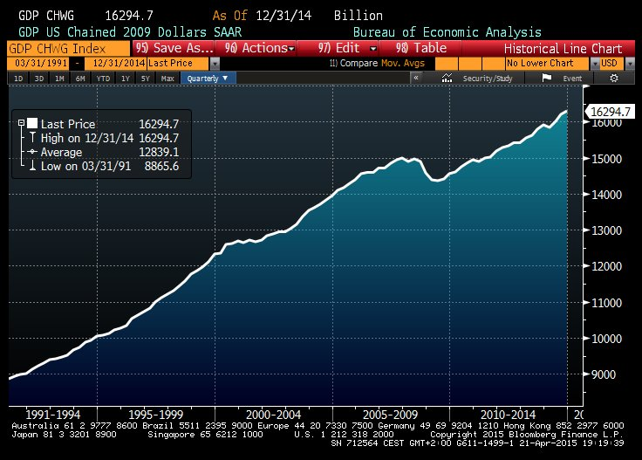
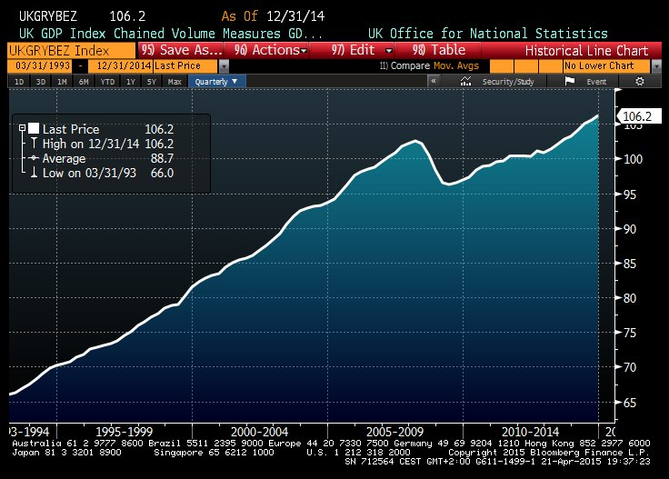
Country evidence on GDP post-crisis performance
Real GDP in the USA
Real GDP in the UK
Source: Bloomberg, National Statistical Institutes

Slide 35





Country evidence on GDP post-crisis performance
Real GDP in Germany
Real GDP in France
Real GDP in Eurozone
Real GDP in Spain
Real GDP in Italy
Source: Bloomberg, National Statistical Institutes

Slide 36


Secular stagnation debate
Sources: CBO, BEA, IMF; Larry Summers, “Reflections on the ‘New Secular Stagnation Hypothesis’, in C. Teulings & R. Baldwin (eds.) Secular Stagnation: Facts, Causes and Consequences, VoxEU.org & CEPR, 2014
  Output is way lower than we thought before the crisis it was going to be
  Most of the difference reflects a sharp downward revision to potential growth, not cyclical conditions
  Consequence: theories/policy prescriptions based on examining fluctuations/volatility around trend are rendered useless

Slide 37


Competing explanations: slowing productivity
Sources: Edward Glaeser, “Secular joblessness’, in C. Teulings & R. Baldwin (eds.) Secular Stagnation: Facts, Causes and Consequences, VoxEU.org & CEPR, 2014
Sources: Robert Gordon, “The turtle’s progress’, in C. Teulings & R. Baldwin (eds.) Secular Stagnation: Facts, Causes and Consequences, VoxEU.org & CEPR, 2014
  Innovations of the past (electricity, internal combustion engine, indoor plumbing) were more effective in boosting productivity and enhancing living standards that the present internet revolution
Failure to invest in infrastructure, education and training
We have completed the achievable increase in education levels

Slide 38


Competing explanations: negative equilibrium real rates
Implications of demographic change for required stock of savings
Sources: C. Teulings & R. Baldwin (eds.) Secular Stagnation: Facts, Causes and Consequences, VoxEU.org & CEPR, 2014
Sources: Mervyn King, “Measuring the World Interest Rate”; Larry Summers, “Reflections on the ‘New Secular Stagnation Hypothesis’, in C. Teulings & R. Baldwin (eds.) Secular Stagnation: Facts, Causes and Consequences, VoxEU.org & CEPR, 2014
  Full employment equilibrium real interest rate is now negative
  But we are constrained by the ZLB (zero lower bound)
Why has the real interest rate might have moved lower?
  Higher savings due to demographic factors, balance sheet recession, rising inequality
  Lower investment due to shift to less capital intensive sectors (IT) and lower population growth
We might have to choose between output growth and financial instability
  Ultra-low interest rates needed on a semi-permanent basis will induce bubbles

Slide 39





Demographic challenge: employment growth to collapse
Age distribution, G-19 and Nigeria
Compound annual growth, G-19 and Nigeria
Source: McKinsey Global Institute, “Global Growth: Can Productivity Save the Day in an Aging World?”, 2015
  Employment expanded rapidly between 1964 and 2014 (1.7% CAGR)
  Population growth quickened (from 1.2% to 1.4% per year)
  Rising share of working age cohorts in the population (from 58% to 68%)
But these factors will reverse in coming decades to produce much lower employment growth (0.3%) due to aging of the population
  Population growth to slow down to abut 0.4%
  Working age cohorts share to decline modestly (from 68% to 61%)
  Even under favorable propensity to be employed assumptions, employment growth to decline dramatically
Global number of employees to peak around 2050

Slide 40


With unchanged productivity trends, much lower prosperity awaits
GDP and GDP p.c. At past productivity growth rates, G-19 and Nigeria
Source: McKinsey Global Institute, “Global Growth: Can Productivity Save the Day in an Aging World?”, 2015
  Even if comparatively high productivity levels of the recent past were sustained, prosperity to decline dramatically
  GDP growth to drop about 40%
  GDP per capita to drop about 19%

Slide 41


Is a productivity enhancement possible? Some examples
Sectors with potential productivity gains, G-19 and Nigeria
World Bank’s Ease of Doing Business Index
Source: McKinsey Global Institute, “Global Growth: Can Productivity Save the Day in an Aging World?”, 2015
Source: J. Jimeno, F. Smets & Y. Yiangou, “Secular stagnation: a view from the Eurozone’, in C. Teulings & R. Baldwin (eds.) Secular Stagnation: Facts, Causes and Consequences, VoxEU.org & CEPR, 2014
  Potential productivity gains in selected sectors
  Productivity could be raised up to 4%
“Soft” structural reforms linked to business environment
  Broad package of labor, tax, product and pension reforms could raise GDP p.c. after 10 years by 11% in EU, 5% in US

Slide 42


Current account, competitiveness and corporate margins:
Competitiveness adjustments continue . . . More to come
The peripheral countries still maintain the competitiveness gains achieved in recent years and are likely to continue doing so in coming quarters. This is the case for Greece, Portugal and Ireland . In Spain, the decline in salaries and unit labour costs continues and is significant when analysed at a global level (versus the 37 most-industrialised countries). In the manufacturing sector, Spain is making solid gains in competitiveness.
We would highlight the adjustment in Italy’s nominal compensation per employee, which is falling quite significantly in relative terms. However, this is negatively offset by poor productivity, which means the relative performance of ULCs is still weak.
France is still not experiencing any significant adjustment in relative terms versus the other economies,
In Germany salaries and ULCs are rising in relative terms.

Slide 43

Current account, competitiveness and corporate margins:
No improvement yet in France and Italy
We calculate the GOS (Gross Operating Surplus) as a percentage of the GVA (Gross Value Added) as a proxy of corporate margins.
Spain is well ahead of the rest of the largest economies in terms of margin recovery, courtesy of the big adjustments in the labour market and the flexibility introduced by the government’s reforms. With the recovery of the labour market, margins seem to be stabilising.
Germany seems to be settling at around the 41% level, after having reached more than 45% at the peak, and has started transferring part of these gains in margins to salaries per employee.
Finally, we have not yet seen any significant improvement in margins in France and Italy. In fact, they seem to be deteriorating (or stabilising at best) again in 2014E. We think labour reforms are a pre-condition for margins to improve in both countries. Until then, the current situation is unlikely to change.

Slide 44



Deflation fears abating

Slide 45
Inflation:
Core inflation is much more stable
After falling sharply in 2013, Euro zone core inflation has stabilized at around 0.8% YoY in 2014. Risks are biased to the downside, due to disappointing GDP figures (stagnant in 2Q14) and deteriorating confidence surveys in 3Q14 (in our view, this is mainly related to the trend in exports). We believe that a large part of the deterioration in growth is caused by temporary factors, so we remain confident about a return to growth in the second half of the year and a strengthening in 2015. This would underpin a gradual rise in core inflation, in particular in non-energy industrial goods.
The breakdown of harmonized CPI at constant taxes (to avoid the distortion of indirect taxation on final prices) helps us identify the components that have been driving inflation lower in recent months, linked to the performance of oil and food prices. 27% of the CPI basket posted a negative annual rate in September 2014, although here there were significant divergences between countries. The lowest number is in Germany, with 20% of the total CPI basket in negative territory, followed by France (38%), Italy (40%) and Spain (47%).

Slide 46


Inflation:
Inflation forecasts
We have significantly reduced our estimates for inflation in the Euro zone and the biggest member states in 2014E and 2015E since our last strategy report in June this year (from 0.9% for 2014E and 1.7% in 2015E in our last report in June).
The main reasons for this are the strong euro exchange rate, oil prices and unprocessed food prices on the downside, along with the limited impact on final prices of the last VAT hikes (in France and Italy) due to weak domestic demand. We have also cut our forecast for Euro zone GDP, mainly due to the disappointing performance in Germany and Italy. As shown below, we expect Euro zone inflation to be contained in 2016E and to stay below the ECB’s threshold of 2.0% YoY. Germany is likely to have the highest inflation rate, but should not be a great cause of concern for the ECB. We see risks for inflation biased to the downside and think it will remain very dependent on the direction of oil prices.

Slide 47

Inflation: Deconstructing the final demand deflator
Import prices negative contribution and euro positive one more relevant now.
Germany: Moderate ULC (wage growth partly offset by productivity gains), increase in GOS.
France: Recovery in GOS.
Italy: the least affected by import prices
Spain: import prices and the euro are significant elements.

Slide 48



Why worry about ”lowflation”/”deflation”?
Real interest rates and debt as % of GDP
Spain: Nominal and real wage adjustment
Sources: IMF
Debt deflation channel: it makes debt more difficult to be repaid
  An issue for the most indebted countries/sectors
Erodes competitiveness: It partly offsets the impact on real wages of a nominal wage adjustment
  Given inertia in wage-setting, it makes the burden of adjustment fall more on the quantity space (unemployment) and less on prices (real wages)
Inhibits spending: consumers, investors postpone spending decisions waiting for lower prices

Slide 49

Taking stock of structural reforms:
Calibrating the impact of reforms
Euro zone countries (notably, but not exclusively, those in the periphery) have scope for structural reforms in many fields: product market regulation and competition, professional services (where entry barriers and protection from competition lead to abnormally high returns and inefficiencies), credit markets (addressed elsewhere in this report), R&D and the digital economy, tax shifts away from labour income and into consumption and, critically, changes to the labour market.
Closing the gap with the best performing countries can lead to large potential gains in output and employment, and the results would be even more significant if the countries were to act together on reform. The European Commission has estimated that the reforms would boost GDP between 2.6% and 14.8% after 10 years, with the largest contribution coming from labour market reforms that increase participation. A strand of academic discussion has argued reforms could be counter-productive in the short term if monetary policy is constrained at the zero lower bound, but analytical work by the European Commission finds no support for such claim.

Slide 50

Taking stock of structural reforms:
Germany, still some pending issues to be addressed

Slide 51




Taking stock of structural reforms:
France, a challenging path ahead & hard-to-forge consensus

Slide 52


Taking stock of structural reforms:
Italy: Reform agenda gradually implemented, but more is needed

Slide 53




Taking stock of structural reforms:
Spain, a resounding success but more needs to be done

Slide 54


Emerging markets:
Slower growth, less trade and the global value chain

Slide 55


Emerging markets:
Capital (out) flows
Net capital outflows from 15 largest emerging markets rose to $600.1bn in the 3Q14-1Q15, which is even higher than the 545.2bn outflows in 2Q08-1Q09.
        - Unwinding of carry trades
        - Growth decay
However, that pales compared to the $2.2tn capital inflows from July 2009 to June 2014.
Plunge in foreign exchange reserves. FX reserves declined by $374.4bn in 1Q15
        - Defending the local currencies against USD appreciation
        - Slower export growth

Slide 56
Emerging markets:
Increasingly pivotal role of China
While it might sound like a platitude to state the increasingly important role of China in the global economy, a few numbers (such as those shown in the charts) help to illustrate the pivotal role that China has come to play in global demand, and its rising importance as an export destination not only for most other emerging markets –particularly those in Asia and commodity exporters in Asia and Latin America- but also for advanced economies, as well as an equally key supplier of imports to those countries. China has quickly surpassed the US (or is about to surpass it) as an export trading partner, highlighting the importance of economic conditions in China for the global economic cycle. China remains somewhat more opaque than other large economic blocs such as the US, Japan or Western Europe, so in a way it is harder to ascertain what exactly is going on at a particular point in time and to monitor developments as accurately as in other countries. An unexpected change in China’s economic conditions (either to the upside or to the downside) can easily catch the world off-guard.

Slide 57

Emerging markets:
Don’t lose sight of the big picture

Slide 58

58
Economic projections
Economic projections
  Eurozone
  Germany
  France
  Italy
  Spain
  UK
  US

Slide 59

59
Summary of economic projections

Slide 60
Euro zone: Euro zone GDP: 1.6% in 2015E and 2.0% in 2016E
After the release of 1Q15 numbers, we have introduced a modest revision to our 2015E GDP estimates, revising GDP growth downwards to 1.6% from 1.7% previously. At the same time, we maintain our estimates on 2016E at 2.0% and the main views on the recovery process and the composition of GDP growth. We expect internal demand to be the main driver of GDP growth this year and next, with private consumption going up by 1.8%, public consumption increasing 1.2% and investments also moving up by a relatively string 1.9%. On the contrary, the external sector should trim 0.2pp of GDP growth this year and adding 0.2pp next. Despite that the depreciation of the Euro is helping exports to have a good performance, the stronger growth rates forecasted for internal demand are also pushing imports growth rates higher. The problem with exports would come more from the weakness of internal demand in the destination countries rather than by a loss of competitiveness of Euro zone. Regarding prices, we expect modest growth rates in inflation this year and next. Unemployment will keep falling, like the budget deficit, while the CA surplus would remain.

Slide 61
Germany: German GDP: 2.0% in 2015E and 2.5% in 2016E
Germany still remains as one of our preferred economies in the Euro area. Despite that we have revised downwards our estimates for 2015E GDP growth, on the back of weaker than expected performance (0.3% QoQ) of the economy in 1Q15, we believe that fundamentals are strong and would push GDP growth to 2.0% this year and 2.5% next. Growth in 1Q15 has been in our view misleading, since the headline performance does not reflect the real strength of the breakdown. Internal demand is accelerating its growth rates, with domestic final sales up by 0.8% QoQ in 1Q15 and private domestic final sales growing by 0.9% QoQ in the same quarter. Weakness in the 1Q15 came from negative contributions of net exports and inventories. We expect a rebound in 2Q15E GDP growth and relatively strong growth rates during the rest of the year. Fundamentals for private consumption and investments are still quiet strong and numbers are finally reflecting that, while public consumption should also accelerate this year and next. Inflation should move towards 2.0% next year while the unemployment rate could probably decline again.

Slide 62
France: French GDP: 1.2% in 2015E and 1.5% in 2016E
The French economy surprised on the upside in 1Q15, after growing by 0.55% QoQ (the strongest growth rate since 2Q13). The annual growth rate accelerated to 0.7%. 1Q15 GDP growth was slightly better than what we expected (0.4% QoQ) so we have not had to introduce any significant change in our annual estimates for GDP growth. We have revised upwards to 1.2% from 1.1% our 2015E GDP growth estimate, while maintaining 2016E estimates at 1.5%. The downward revision introduced to 2014 numbers also helps to explain this change in our forecasts. Despite this upward revision, economic fundamentals are still not string enough to justify much higher growth rates in the short run. The composition of GDP growth is still quite biased to private consumption and public consumption, with investments still suffering. 1Q15 GDP growth was also helped by an accumulation of inventories, while net exports trimmed 0.5pp of GDP growth. Excluding inventories, growth in 2015E could be limited to just 0.7%, while private domestic final sales would go up by 0.9% this year. We are still expecting the impact on growth. of the reforms already approved.

Slide 63
Italy: Italian GDP: 0.7% in 2015E and 1.2% in 2016E
The Italian economy confirmed the recovery process in which is immersed in 1Q15 numbers. After having been in recession since 2011, the economy grew by 0.3% QoQ in 1Q15. Despite this positive growth rate seen in the first quarter of the year, the breakdown of 1Q numbers is not as good as what the headline could suggest. Private consumption is still very weak and not likely to improve substantially during the rest of the year, despite that it should be positive, in our view. The performance of investments in 1Q was positive, but mainly thanks to the fantastic performance of transport goods (28.7% QoQ) which in our view is not sustainable in coming quarters. The external sector had a negative contribution to growth rates due to the lack of traction in exports and a rebound in imports. Finally, there was an accumulation in inventories. In summary, the economy is moving forward, it is improving but there is still a lot to do before having high quality numbers in the GDP breakdown. We maintain our growth estimates for this year and next and believe that reforms will have a positive impact on GDP growth in coming years.

Slide 64
Spain: Spanish GDP: 1.4% in 2014; 3.0% in 2015E and 3.0% in 2016E
We maintain our forecasts for the Spanish economic growth this year and next. We believe the economy is likely to grow by 3.0% in both years and could actually maintain those growth rates going forward. In our view, fundamentals are strengthening and risks are progressively coming down. The composition of GDP growth is also changing and getting more stable than in the past. The first phase of the economic recovery is already behind us and growth is progressively being explained more and more by internal demand instead that by just the external sector. Private consumption would grow around 3.0% this year and next, with households income fundamentals improving, thanks to the recovery in employment, healthier balance sheets and tax cuts. The improvement in consumer confidence, together with the pent up demand generated during the recession years, is also driving consumption upwards. Investments also show a very good performance, thanks to the strong recovery in business activity and the need of increasing progressively and, modestly in the short run, capacity in some sectors.
Notes:
64

Slide 65
UK: Decisive election clears the way for growth
The UK economy has experienced an eventful start to 2015, with growth slowing to just 0.3% q-o-q in Q1 and the general election providing an unexpectedly decisive outcome. The threat of a prolonged period of coalition-building in the event of an indecisive election, or even the prospect of a second vote in H2, had appeared as key risks facing UK growth this year. Although the EU referendum – likely to occur in H1-17 – and questions over Scottish devolution will worry some, we do not expect such issues to weigh on activity this year. We continue to expect 2015 GDP growth of 2.4% - fractionally below the consensus forecast – and look for activity to rebound in Q2, with a degree of the weakness seen in the first quarter – caused predominantly by the volatile construction data - also likely to be revised away, in our opinion. Overall, we expect the structure of UK growth in 2015 to look very similar to that of 2014, although the ‘star’ of the recovery to date – very strong employment growth – is in our view likely to prove a more troublesome issue for the Bank of England in the final months of the year given continued disappointment around productivity. With wage inflation now finally on the rise, we believe that the labour data will remain at the centre of the policy debate, and expect an interest rate hike before year-end.

Slide 66
US: US GDP: 2.4% in 2015E and 3.0% in 2016E.
We have revised downwards 2015E GDP growth to 2.4% from 2.7% previously on the back of the negative 1Q15 GDP growth. The US economy keeps moving in the right direction. Despite that 1Q15 GDP growth was disappointing with a decline of 0.7% SAAR, in our view, prospects for economic performance during the rest of the year are much better. Once factors that have been negatively affecting 1Q15 GDP growth disappear, the economy would move up again, growing at rates around 3.0%. Before normalising GDP growth, we will probably see a sharp rebound in 2Q15E, for which we estimate GDP to advance by 4.0% SAAR. The performance of the external sector, inventories and some components of investments would be key in order to reach this strong growth rate in 2Q15E. Once visibility about the future performance of the economy increases and it becomes clearer that 1Q15 GDP growth was a one off, the Federal Reserve will move again into “lift-off” mode. We maintain our view that September will be the chosen FOMC meeting to introduce the first interest rates hike of the new cycle.

