Slide 1
Cross-Border Enforcement Proceeding Tool
Janek Pool
Chairman of the Assembly of Bailiffs of Estonia

Slide 2
CEPT project
Preliminary analysis was done in 2009.
Development was done 2013-2015.
Partners were:
Ministry of Justice of Estonia
Chamber of Bailiffs and Trustees in Bankruptcy of Estonia
UIHJ;
Lithuanian Chamber of Bailiffs;
Council of Latvian Judicial Officers.
Project was co-funded by the European Union.

Slide 3
Problems today
Cross-border enforcement documents are currently sent to competent judicial officers on paper.
No way to verify digitally sent documents' authenticity.
Creditor is burdened by the obligation to translate necessary documents to the official language of the receiving Member State.
Insufficient information about competent judicial officers in other Member States.

Slide 4
Objective
The objective of the creation of the Cross-Border Enforcement Proceeding Tool is
to develop an online cross-border enforcement proceeding tool for EU citizens, businesses and bailiffs, enabling to start an enforcement process;
to archive and send relevant documents and data electronically to other EU member states.

Slide 5
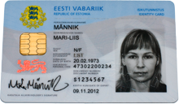
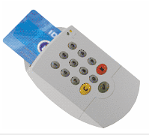
Identification of person
Electronic ID-card or residence permit card
Official identity document in Estonia

Slide 6
Estonian e-Residency

Slide 7
CEPT cover view

Slide 8
Administration of inquiries

Slide 9
Administration of application of enforcement

Slide 10
To start using CEPT
Contact Estonian Chamber of Bailiffs and Trustees in Bankruptcy
info@kpkoda.ee
You will receive application files with set-up instructions.

Slide 11
Thank you - Merci
Janek Pool
Chairman of the Assembly of Bailiffs of Estonia

