Slide 1
Innovative Rule of Law Initiative Enforcement Toolkit Jos Uitdehaag

Slide 2
Legal reform: justice for everybody

Slide 3
Innovating Justice
Collaborative effort from five legal organizations: - CILC: Center for International Legal Cooperation
- Hague Institute for the Internationalisation of Law
- Microjustice Initiative
- European Academy for Law and Legislation
- Tilburg Institute for Interdisciplinary Studies of Civil Law and Conflict Resolution Systems
Subsidized by: Dutch Ministry of Economic Affairs, Agriculture and Innovation and the city of The Hague.

Slide 4
Rule of Law: innovation is necessary:
Innovation is necessary:
fundamental rights, government power, absence of corruption, order and security, access to civil justice, effective criminal justice and informal justice and, of course, effective regulatory enforcement.

Slide 5
Rule of Law
Success in providing, improving and strengthening Rule of Law remains mixed, modest, and hard to measure.
Achieving real change in this sector has proven to be difficult.
Aim of the project: to create a platform, in which Rule of Law experts can share experiences, showcase their innovations and learn from each other´s efforts.

Slide 6
Toolkit Enforcement
Acting as a road map, the toolkit will help countries and organizations introduce an enforcement law system.
Instead of imposing one specific system, it provides several possibilities, using best practices from different countries.

Slide 7
Setting standards
When completed the toolkit:
will present a unique and interlinked framework consisting of general and international principles, which together will provide minimum standards for enforcement law;
will list best practices;
when applied will provide insight into the relationship between enforcement law and the rule of law in the country concerned;
will provide a working method for reforming enforcement law, which can be used by countries and organizations.

Slide 8
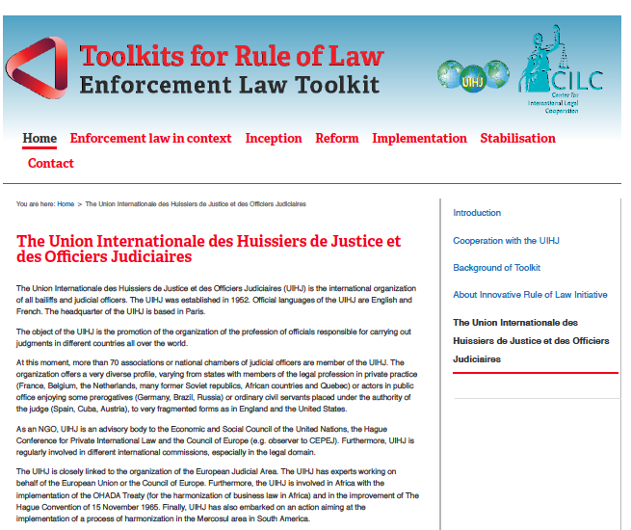

Slide 9
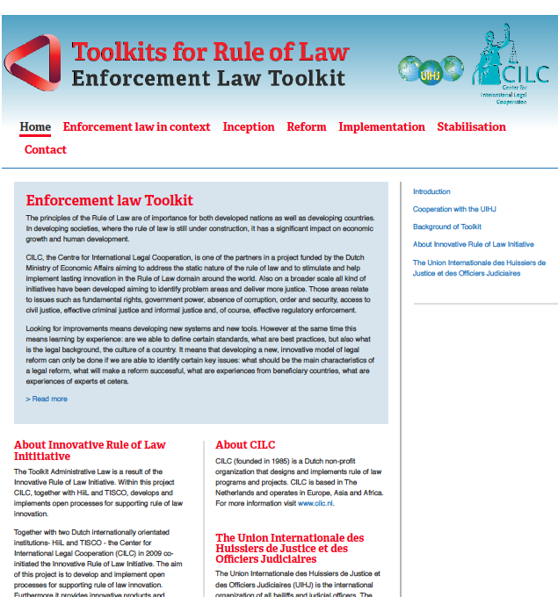

Slide 10
Thank you - Merci

