Slide 1
Debtor in Estonian enforcement proceedings and options for debt rescheduling
Tallinn Bailiff and Trustee in Bankruptcy
Elin Vilippus

Slide 2
Estonian enforcement system
Freelance bailiffs
No refunds from the government
Outcome depends on
debtors’ financial situation
bailiff’s activity

Slide 3
men vs women and their age

Slide 4
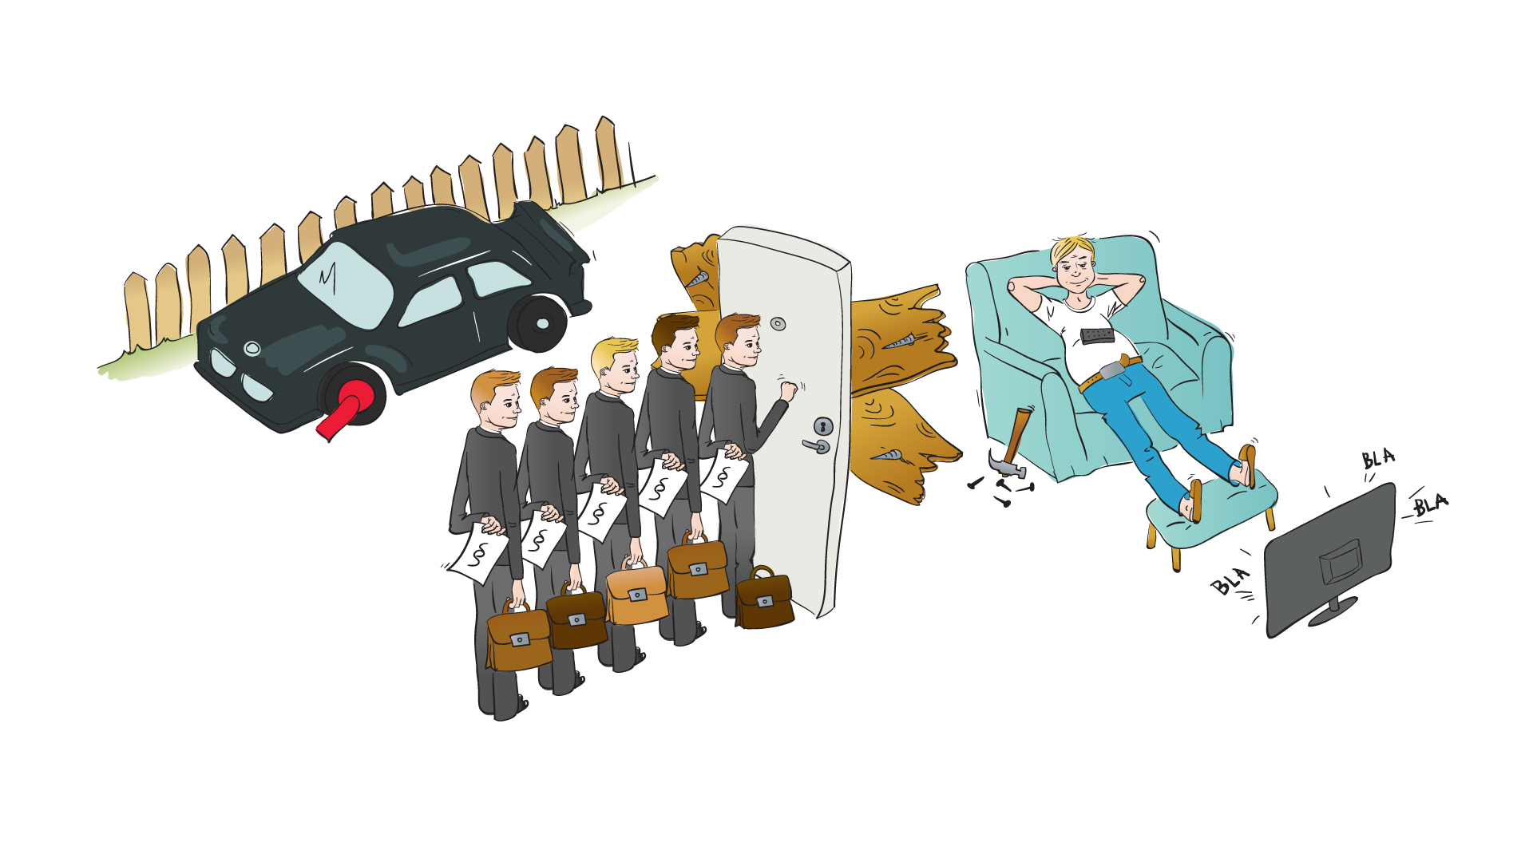
Average debtor in my office: male, age 31-40, no income

Slide 5
Assets
12% has at least one property
5% has at least one vehicle with a valid insurance, but most of them are old (1998-2003)
45% have nothing – no income or assets
38% of debtors have 2-5 pending enforcement cases
10% have 21 or more pending proceedings.
The enforcement cases of ca 35% of debtors are processed by 3-5 bailiffs at the same time.

Slide 6
Debt rescheduling
At the stage of enforcement proceedings it is, as a rule, too late for rescheduling – quite strict conditions apply.
Two options:
Agreement with a claimant
Application to the court

Slide 7
Agreement with a claimant
Is made on claimant’s terms
Bailiff has no right to alter those conditions
but
Bailiff gives claimant advice on debtor’s financial perspective

Slide 8
Rescheduling through court
Enforcement proceedings must be extremely unfair;
Conditions must be exceptional;
Interests of the claimant have to be taken into account.
CEP § 45:
states the right to apply for rescheduling
is interpreted in restrictive manner

Slide 9
Rescheduling through court
Exceptional circumstances:
debtor has small children, is seriously ill or is in a very advanced age; other similar circumstances;
losing one’s home is, as a rule, not considered to be exceptional;
Goal:
to achieve optimal balance between creditor’s and debtor’s rights
not to replace/postpone bankruptcy

Slide 10
Thank you! Merci!
Tallinn Bailiff and Trustee in Bankruptcy
Elin Vilippus

