Slide 1
Electronic cross border Justice in Europe in practice
Ernst Steigenga
Manager Dutch contribution to e-CODEX
Process manager digital interaction EAPO in e-SENS

Slide 2
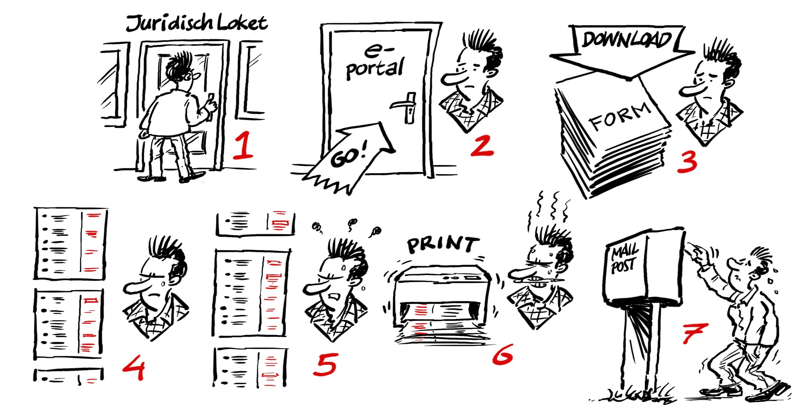
From
Notes:
Met andere woorden de doelstellingen van e-Codex…

Slide 3
To ...

Slide 4
Large scale pilots in Europe
Competiveness and Innovation Program ICT policy support from DG Connect – 50% funding
e-CODEX
e-Justice
20 countries, 25 partners
1-12-2010 – 31-5-2016 (final date)
€24Mio
e-SENS
Justice, Procurement, Health, Business lifecycle
22 countries, >100 partners
1-4-2013 - 31-3-2016 (extension possible)
€25 Mio

Slide 5
e-Justice conference 2016
Day 1 Closing event e-CODEX
Opening by ministers of Justice NL and NRW and Eurocommissioner Justice
Stakeholders on stage
Succes stories e-CODEX from civil and criminal law
Day 2 e-Justice
1st steps to 3rd European e-Justice Action Plan
Handover e-CODEX heritage to Eurocommissioner

Slide 6
Example use cases in Justice
European Procedure for Payment Order (1896/2006)
European Small Claims Procedure (861/2007)
European Account Preservation Order (655/2014)
Implementation from 1-1-2017
Citizens, Companies, Bailiffs, Legal Officers, Banks, Judges and other legal professionals
e-SENS develops example digital interaction based on preliminary forms – see examples in next slides

Slide 7
Current Practice Small Claims Form A
7.3 Are you claiming the costs of proceedings? 7.3.1. Yes ❒ 7.3.2. No ❒ 7.3.3. If yes, please specify which costs and indicate the amount claimed or incurred so far:
7.4. Are you claiming interest? Yes ❒ No ❒ if yes, is the interest: Contractual? ❒ if so, go to 7.4.1 Statutory? ❒ If so, go to 7.4.2 7.4.1. If contractual (1)the rate is: ❒ .........................% ❒ .........................% above the base rate of the ECB ❒ other: ........................................ (2) the interest should run from: .............. /............... /............ (date) 7.4.2. If statutory the interest should run from: ........... /.............. /............... (date)

Slide 8
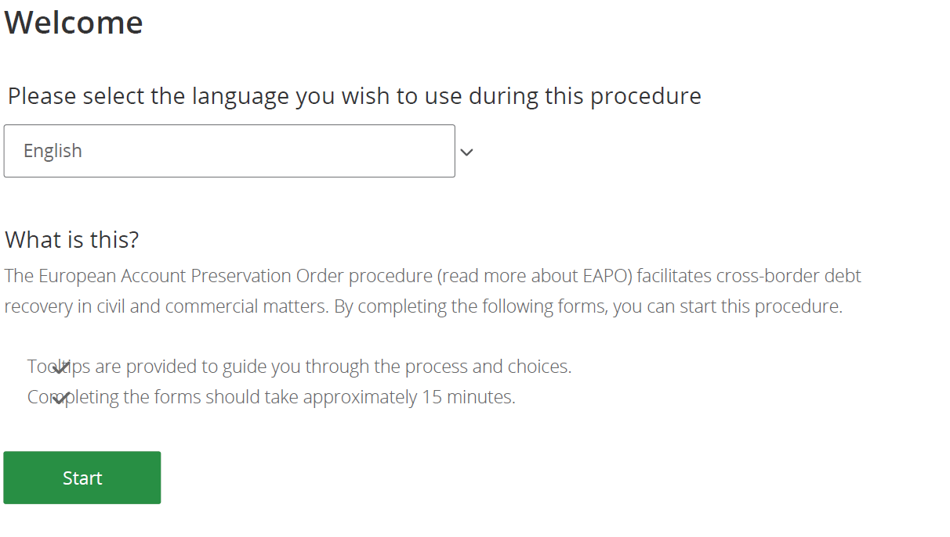
Snap shot 1st design EAPO - I

Slide 9
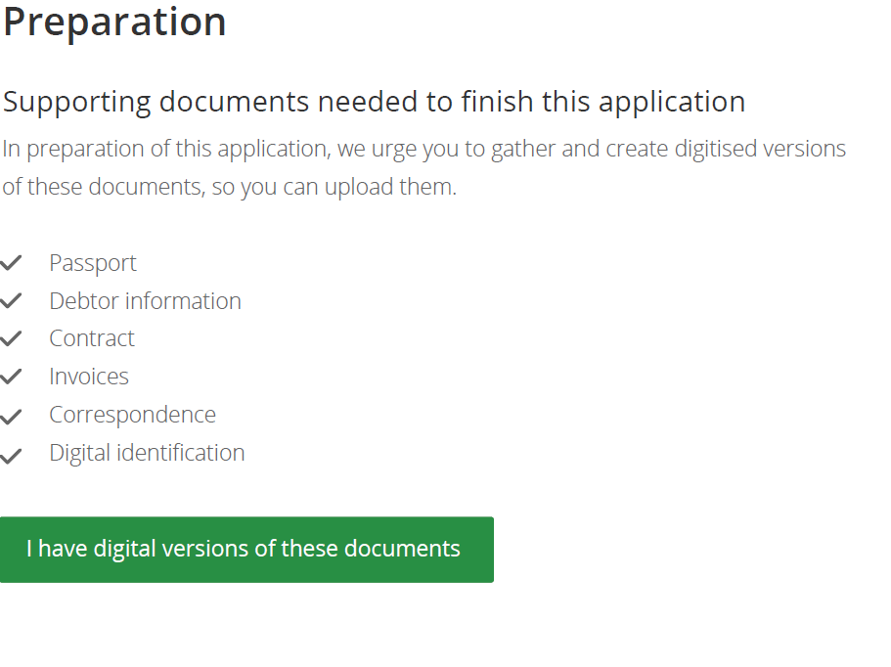
Snap shot 1st design EAPO - II

Slide 10
Electronic cross border Justice in practice in Europe
 | Piloting | Testing | System set up | Piloting intention | Other
EPO | AT, DE, EE, IT, GR | PL | FR, NL
Small Claims |  | CZ, PL | FR, DE, AT, NL
MLA | DE, BE, NL |  | ES, FR | AT, GR, UK, TR
FD 909 |  | BE, NL, FR
EAW |  |  | CCBE, FR, NL, ES
Financial Penalties |  |  | FR, BE, HU | NL, DE
Business Registers | IE, IT, DE |  | AT, FR, DE | GR

Slide 11
Get Connected
Find your national coordinator for e-CODEX or e-SENS
www.e-codex.eu
www.youtube.com/watch?v=p-bS_N7eZmI
Example for digital interaction EAPO available through www.esens.eu by late June 2015

Slide 12
Thank you - Merci
Ernst Steigenga
e.j.steigenga@minvenj.nl, +31653337374
Process manager digital interaction EAPO

